Slide 1
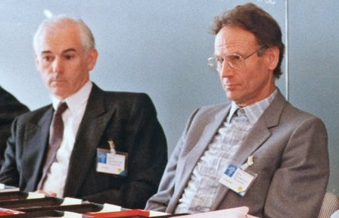
Daniel Enard 1939-2008 🇫🇷 Raymond Wilson 1928-2018 🇬🇧
D. Enard, VLT Optical Engineer, ESO
R. Wilson, NTT Designer, Active optics, ESO

Slide 2
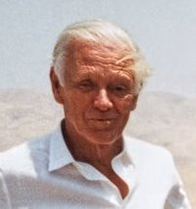
Lodewijk Woltjer 1930 – 2019. 🇳🇱
ESO Director general 1975-1987
Initiator and father of the VLT
Early supporter of the VLTI

Slide 3
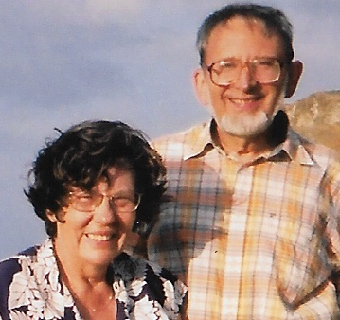
François Roddier 1936 – 2023 🇫🇷
Theory of high resolution imaging
New concept of adaptive optics
Observations at CFHT

Slide 4
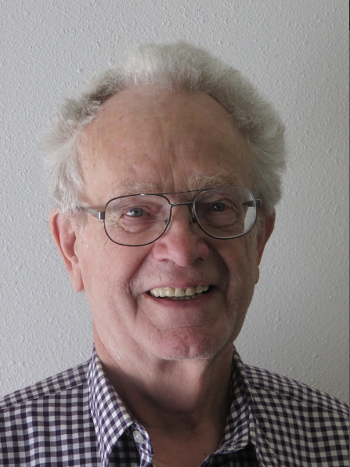
Jacques Beckers 1934 – 2021 🇳🇱 🇺🇸
Solar astronomer (Sacramento Peak)
NNTT Project group 1980-199O (NOAO, Tucson)
VLTI Head at ESO for implementation (1988-1992)

Slide 5
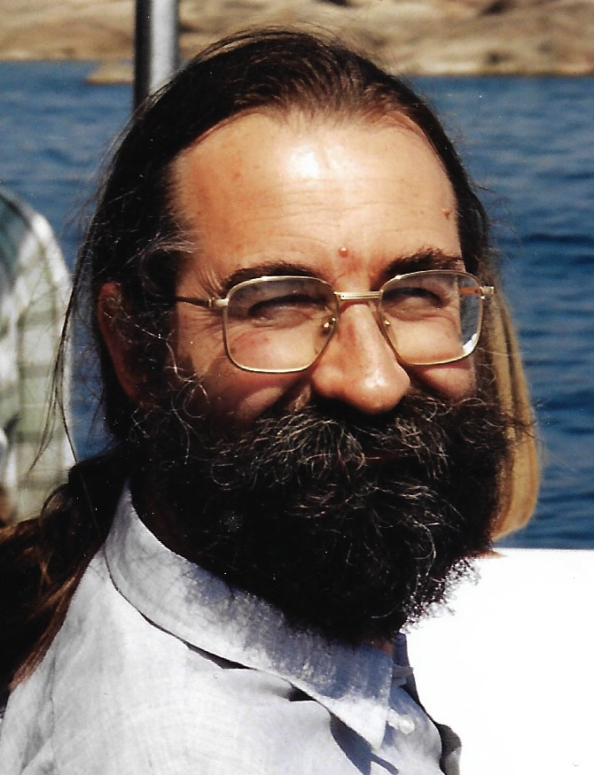
Jean-Marie Mariotti 1955 – 1998. 🇫🇷
Astronomer & Optician
Infrared interferometry (Meudon, Torino)
VLTI Head (1995-1998) at ESO

Slide 6
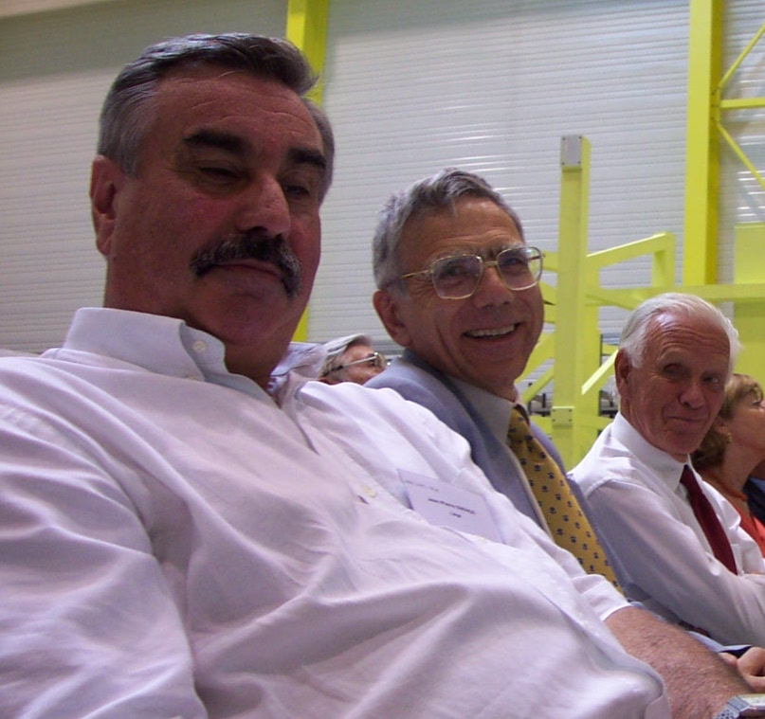
Jean-Pierre Swings 1943 – 2023 🇧🇪
Astronomer (Liège)
Chair of VLT Working Group (1980 – 1986)
Member, VLTI Working Group (1984-1987)

Slide 7
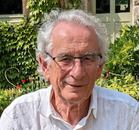
Renaud Foy 1944 - 2024 🇫🇷
Astronomer
Speckle interferometry
Laser star(1985) with A. Labeyrie

Slide 8
Leonid Weliachew 1936 – 1986 🇫🇷
Radioastronomer (Meudon, IRAM)
VLTI Consultant

Slide 9
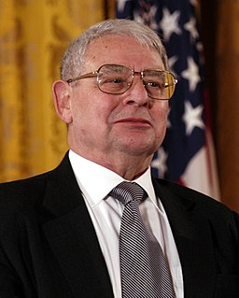
Riccardo Giacconi 1931 – 1999 🇨🇮 🇺🇸
ESO DG 1993-1999
Recovery plan for Adaptive optics and VLTI

Slide 10
Absents, vivants
Christian Perrier
Dennis Downes
James Lequeux
François Sibille
Paolo di Benedetto
Harry van der Laan
Massimo Tarenghi
Jan Wijnbergen
Marc Sarazin
Oberto Citterio

